Slide 1

Tokyo, Japan Airbnb Listing Classification
By: Rakim T. Reid
June 7, 2023
Capstone II – Supervised Learning Presentation

Slide 2
What is Airbnb?
An online marketplace for short and long term stay experiences.
Acts as a broker and charges a commission from each booking.
Some controversy due to altering the rental industry.

Slide 3

Data Source
Inside Airbnb: http://insideairbnb.com/
A “mission driven project that provides data and advocacy about Airbnb's impact on residential communities.
We work towards a vision where data and information empower communities to understand, decide and control the role of renting residential homes to tourists.”

Slide 4

Dataset
Q1 2023 Tokyo, Japan Airbnb Listings (January 1 – March 31)
10,127 listings (rows)
A year of data available but…

Slide 5
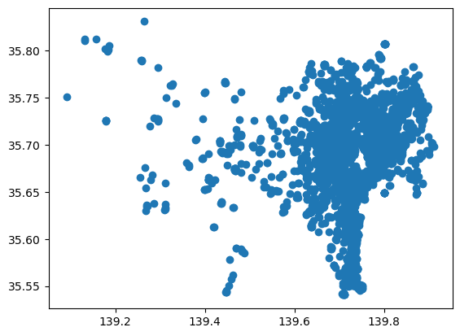
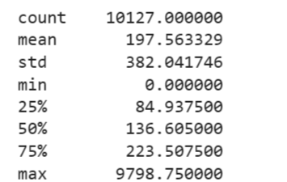
Exploratory Data Analysis

Slide 6
Challenges
Outliers
Tokyo, Japan geography, population density and seasonality effects in rentals and blunted tourism numbers due to reopening after COVID-19 pandemic.
Numbers are not at pre-pandemic levels yet. China is the biggest source of tourism, but lockdowns were in place for part of this period. Japan just opened up in October 2022.
Originally wanted to do a regression analysis with price as a continuous variable (a number). 1% to 5% accuracy/explanatory power.

Slide 7

Then I Remembered…

Slide 8

Everyone does housing price predictions!!!

Slide 9

Regression Model Classification Model
Out with the poor performing regression models and in with the new classification model.
Instead of price prediction with price as a continuous variable, I chose to see if the features could classify whether a listing was for a full apartment/house or not (some other type of housing property like a hotel, room etc.)

Slide 10
Methods
Random Forest
Decision Tree
Support Vector Machine
XGBoost
Extra Trees (extremely randomized trees)

Slide 11

Model Specification
* Out of 100% and from Random Forest Model
Price: 35.9060%
Availability_365: 19.3545
Host_Listing_Count: 18.1352%
Number of Reviews: 17.7966%
Minimum_Nights: 8.8077%

Slide 12
Results – Model ACCURACY Scores
Random Forest (tuned): 85.39%
Decision Tree: 78.48%
Support Vector Machine: 74.03%
XGBoost (untuned): 85%
Extra Trees (untuned): 86%

Slide 13

Model Chosen: Random Forest

Slide 14
Practical MODEL USES FOR AN AUDIENCE OF INTEREST
Knowledge sharing for travel industry.
Airbnb algorithm tuning for marketing initiatives.
Host competition analysis – know which traits a full apartment or house have on Airbnb and pursue the same (e.g. get more reviews).

Slide 15
Model Limitations
Tokyo, Japan
Features used
Used classification algorithm instead of regression.
Had to choose accuracy over precise price output. This means I had to do a binary classification. 1 if a full apartment/house or 0 if not.

Slide 16

Future PROJECTS
Use Extra Tree Model and tune it to produce even better results.
Turn this project into a web app.
Use feature engineering to combine variables.
Price prediction. Tried it as classification with random forest and got 75% accuracy.

Slide 17
Conclusion
Classification models may yield better predictive accuracy than regressions for this type of dataset.
Tree-based models and deep learning techniques tend to produce better results. Probably given these types of models mimic how humans think.
Supervised learning models are viable approach to learning more about Airbnb listings.

Slide 18

Questions?

Slide 19

Thank you! / arigato! /ありがとう!

